Slide 1


PowerPoint Accessibility Enhancer
An AI-powered solution making presentations accessible to everyone. Our tool transforms standard PowerPoint slides into inclusive content for all users.
by Ibnfarabi shihab

Slide 2
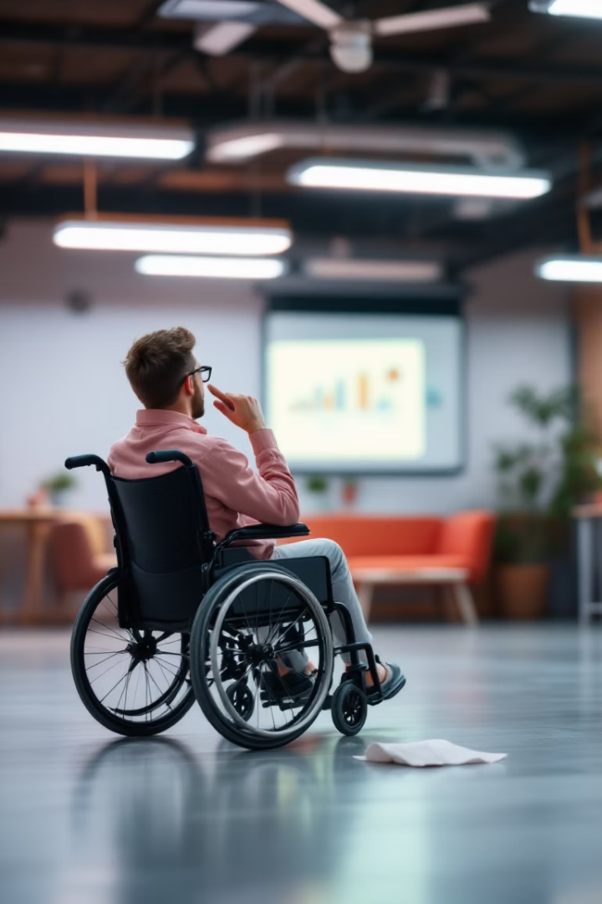




The Accessibility Challenge
Missing Alt Text
Images lack descriptive text for screen readers.
Poor Color Contrast
Text difficult to distinguish from backgrounds.
Small Font Sizes
Text below 18pt creates readability barriers.
Inconsistent Structure
Confusing layouts impede comprehension.

Slide 3








Our Solution
Detailed Reports
Comprehensive accessibility feedback
Automatic Enhancement
One-click accessibility improvements
Analysis Engine
WCAG-compliant evaluation
Cross-Platform App
Works on Windows, macOS, Linux

Slide 4
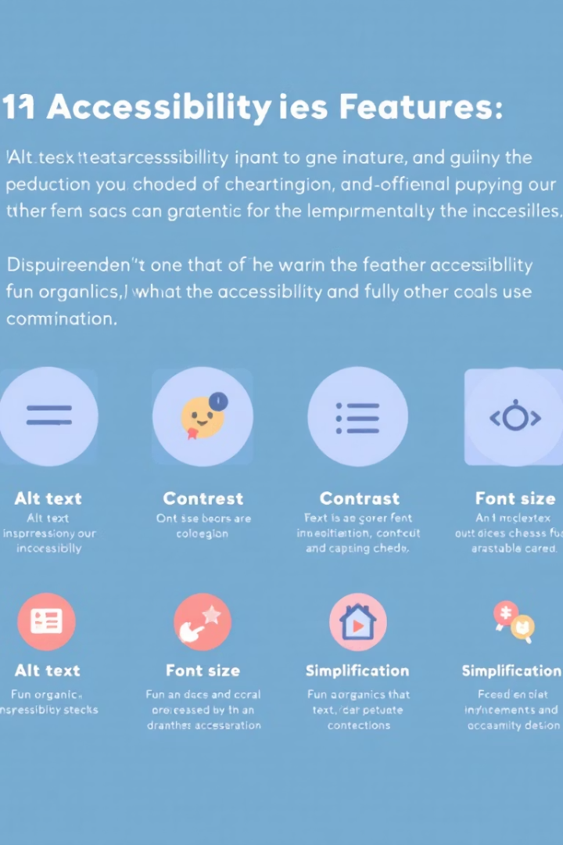




Key Features
WCAG Analysis
Standards-based accessibility evaluation
AI Alt Text
Automatic image descriptions
Font & Color
Size and contrast optimization
Reporting
Detailed HTML accessibility reports

Slide 5








Technical Architecture
Streamlit Frontend
Processing Engine
User-friendly web interface
PowerPoint parsing via python-pptx
Reporting Module
AI Integration
HTML accessibility reports
Ollama + LLaVA models

Slide 6

AI-powered Alt Text Generation
Image Extraction
System identifies and extracts images from PowerPoint slides.
AI Processing
LLaVA model analyzes visual content via Ollama integration.
Context-Aware Description
AI generates relevant, concise image descriptions.
Alt Text Integration
Descriptions are embedded as accessible alt text.

Slide 7
Font & Color Optimization
Font Size Enhancement
Color Contrast Improvement
Detects text below 18pt
Calculates WCAG contrast ratios
Adjusts sizes proportionally
Adjusts to 4.5:1 minimum ratio
Preserves visual hierarchy
Smart color adjustment algorithms
Maintains layout integrity
Preserves brand aesthetics

Slide 8
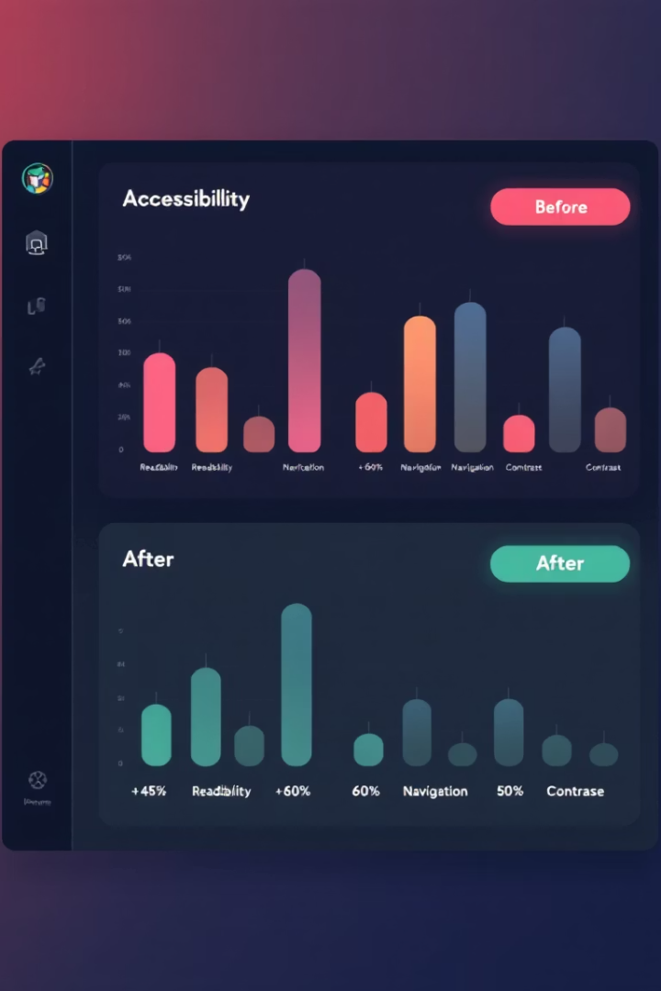
Text Simplification & Reports
Readability Analysis
Text Simplification
Flesch-Kincaid scoring
Plain language alternatives
Complexity detection
Jargon identification
Sentence restructuring
Vocabulary suggestions
Comprehensive Reports
Slide-by-slide analysis
Before/after comparisons
Exportable HTML format

Slide 9








Implementation Challenges
AI Integration
Performance
Model optimization for speed and accuracy.
Processing large presentations efficiently.
PowerPoint Format
Compatibility
Complex file structure with proprietary elements.
Supporting various versions and platforms.

Slide 10
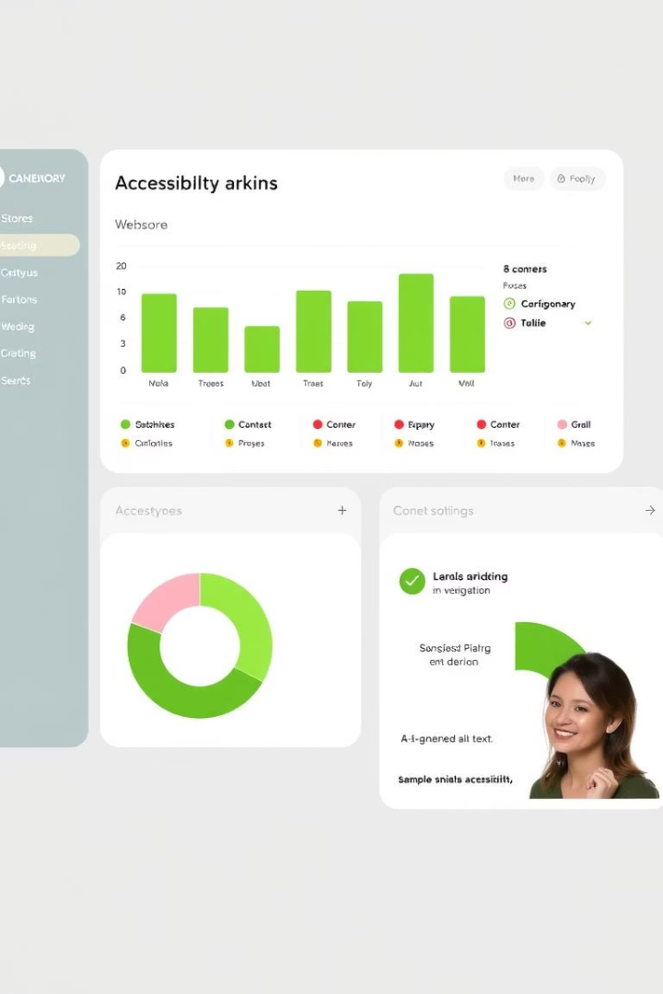




Key Features
Accessibility Analysis
AI Alt Text
Font Optimization
Automatically generates descriptive alt texts for images.
Checks presentations against WCAG standards.
Ensures minimum 18pt font sizes for readability.
Contrast Enhancement
Improves color contrast to meet 4.5:1 ratio.

Slide 11

Deployment & Usage
1
Setup
Install dependencies via requirements.txt
Configure Ollama with LLaVA model
Use launcher scripts or Docker container
2
Workflow
Upload presentation
Run accessibility analysis
Enhance presentation automatically
Download improved version

Slide 12

Testing Results
1
Robust Compatibility
2
Extensive Accessibility Tools
Tested across multiple PowerPoint versions and operating systems.
Validated with screen readers and color contrast analyzers.
3
Handles Complexity
Supports large files and complex slide layouts reliably.

Slide 13
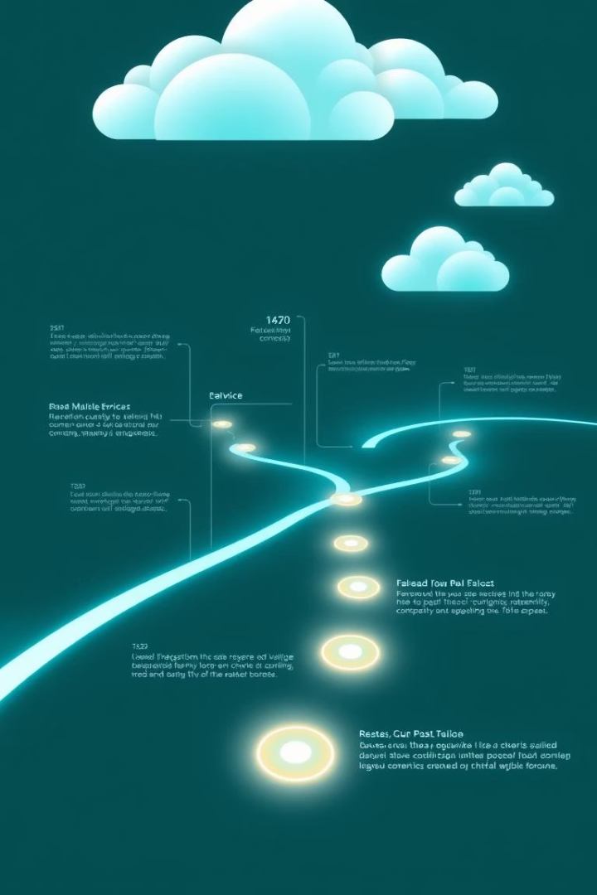




Future Roadmap
Format Expansion
Add support for multiple presentation formats beyond PowerPoint.
Advanced Optimization
Enhance layouts and reading order detection for better flow.
System Integration
Provide API endpoints and batch processing capabilities.
Cloud Deployment
Offer SaaS platform for accessibility enhancement services.

Slide 14

Demo & Questions
Experience a live demonstration of the Accessibility Enhancer.
Engage in a Q&A session to explore features and potential.

